Slide 1
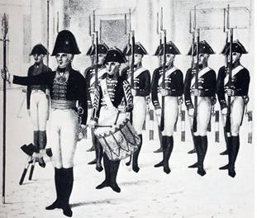
Kantian Duty Ethics

Slide 2
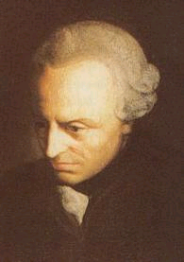
Kantian Duty Ethics
Immanuel Kant
  18th century German Philosopher
  Believed reason could be used to work out a consistent and nonoverridable set of moral principles. Such moral rules would be universal.

Slide 3
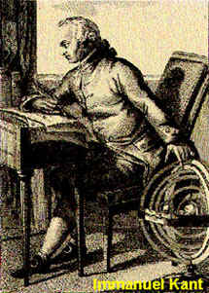
Kantian Duty Ethics
Kant’s ‘Duty’ ethics are a moral obligation which must come from within each individual.
Where do our military duties come from?

Slide 4
“The obligation to do our duty is unconditional. That is, we must do it for the sake of duty, because it is the right thing to do, not because it will profit us psychologically, or economically, not because if we don’t do it and get caught we’ll be punished. The categorical imperative was Kant’s name for this inbred, self-imposed restraint, for the command of conscience within that tells us that the only true moral act is done from a pure sense of duty.” Admiral James Stockdale

Slide 5
Kantian Duty Ethics
What is good?
Only the ‘Good Will.’
Talents of mind, qualities of temperament, personal attributes, while desirable and beneficial can be misused without the Good Will.

Slide 6
Kantian Definitions
What is Right?
“GOOD WILL”: THE INTENTION/CHOICE THAT IMPELS A PERSON TO DO WHAT IS RIGHT, BECAUSE IT IS RIGHT. SELF IMPOSED, THROUGH REASON.
RIGHT ACTIONS: ARE THOSE ACTIONS DONE IN ACCORDANCE WITH “DUTY”
DUTY: ACTION MANDATED BY THE MORAL LAW. DOING THE THINGS YOU ARE PERMITTED BY THE CATEGORICAL IMPERATIVE
CATEGORICAL IMPERATIVE: A MORAL “TEST” FOR RIGHTNESS OF AN ACT
AN ACTION HAS “MORAL WORTH” IF IT CONFORMS TO THE REQUIREMENTS OF DUTY, AND IS DONE FOR THE SAKE OF DUTY, AND NOT FOR SOME OTHER INTENTION
Source: Captain Rubel USNA

Slide 7
Kant’s Categorical Imperative
3 - Formulations
    “Act only according to that maxim by which you can at the same time will that it would become a universal law.”
    Act “as though the maxim of your action were by your will to become a universal law of nature” such as the laws of physics.
    ‘Act so that you treat humanity, whether in you’re your own person or that of another, always as an end and never as a means only.’
- ‘Maxim’ refers to general rule with which agent intends to act.
    - ‘Law’ refers to an objective principle, a ‘maxim’ which passes the test of universalizability.

Slide 8
In Kantian Terms, there is a difference between an action being Blameworthy, Acceptable and Praiseworthy.
BLAMEWORTHY ACCEPTABLE PRAISEWORTHY
- 0 +
|--------------------------------------------------------|--------------------------------------------------|
ACT ACT RIGHTLY ACT RIGHTLY
WRONGLY BUT NOT FROM AND FROM RIGHT
RIGHT MOTIVE MOTIVE (GOOD WILL)
Dr Larry Lengbeyer +
Captain Rubel USNA

Slide 9
Kantian Duty Ethics
Results of Kant’s Categorical Imperative
      one should treat people with respect
      one should never lie
      one should never commit suicide
      one should never break one’s promises
      etc.

Slide 10
Kantian Ethics - Strengths
Realm of duty free from utility
Respect for persons
Golden rule – do unto others, expressed in rational terms
Source: Capt. Rubel USNA

Slide 11
Kantian Ethics - Weaknesses
Hyper-rationality and lack of emotion
The irrelevance of inclination
Overly formal and universal, i.e., most of our duties are in social roles
Inflexibility

Slide 12
Kantian Duty Ethics
How does Kant’s categorical imperative differ from the Golden Rule (“Do unto others as you would have them do unto you”)?

